Slide 1
Heatherside Ward Residents Association Meeting
Monday 21 March 2022

Slide 2
Southampton to London Pipeline Project overview
The Southampton to London Pipeline (SLP) project is replacing 90km of the underground aviation fuel pipeline between Boorley Green, Hampshire and the West London Terminal storage facility in Hounslow.
In October 2020, the project received planning permission – a Development Consent Order.
Construction works to install the replacement pipeline are estimated to take two years between late 2021 and 2023.

Slide 3
Surrey Heath Overview
Around 16km of our replacement underground pipeline runs through Surrey Heath.
The route enters the district from Rushmoor after crossing the River Blackwater and the A331. The route runs along Balmoral Drive and St Catherines Road before crossing St Catherines Road SANG, Frith Hill and Pine Ridge Golf Course. The route then runs north along The Maultway, turning east along Red Road before crossing through Turf Hill and Windlemere SANG. The route continues east through Chobham Common.
It is a complex engineering challenge and we’re working hard to keep construction impacts to a minimum. We are working to minimise the time we spend in specific locations within our two-year programme and once the pipeline is buried, it’ll be a quiet neighbour.

Slide 4
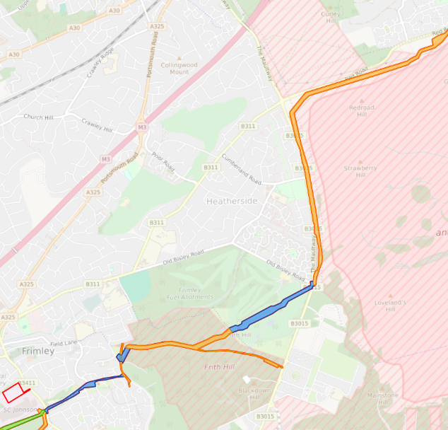
Key areas of interest
St Catherines Road SANG
Access to St Catherines Road SANG will be available throughout installation works.
We will be undertaking some vegetation clearance in September and October 2022.
The construction compound within the SANG will likely be in place from November 2022 to April 2023.
Works will likely take place in December 2022 and January 2023.

Slide 5
Key areas of interest
Frith Hill
Access to Frith Hill will be available throughout installation works.
We are likely to start the compound installation process for Compound 5U in September 2022.
We will likely undertake some vegetation clearance in the working area in December 2022.
Works will likely take place in January, February and March 2023.

Slide 6
Key areas of interest
Colony Bog and Bagshot Heath
Access to Colony Bog and Bagshot Heath will be available throughout installation works.
We will likely undertake some vegetation clearance in the working area in September 2022.
We are likely to start the compound installation process for Compound 5D in October 2022.
Works will likely take place from October 2022 until January 2023.

Slide 7
Voluntary Environmental Investment Programme
The Environmental Investment Programme (EIP) comprises a range of voluntary activities along the replacement pipeline route to fund and/or carry out works within designated sites and/or areas of social/community importance.
It is in addition to any mitigation/reinstatement activities identified within our Environmental Statement.
The project is already required to reinstate any land used by the project and to replant vegetation removed by the project.

Slide 8
Voluntary Environmental Investment Programme
EIP offers in Surrey Heath that are being agreed with the relevant parties.
Location | Activity
Frith Hill | Creation of four glades approximately 60m^{2 ,} to encourage a variety of habitat
Chobham Common | Targeted scrub clearance to increase refuge habitat alongside basking habitat
Chobham Common | Entomology survey at and updating of Wildfire Management Plan to build and enhance the commons management plan.
Folly Bog (Brentmoor Heath) | Research to update invertebrate information for the area to support the management plans.
Location | Activity
Colony Bog/ Bagshot Heath | Bare earth scrapes to create breeding opportunities and egg laying habitat for reptiles and invertebrates.
Colony Bog/Bagshot Heath | Bracken removal and scrub clearance to create opportunities for a greater variety of flora to grow by increasing sunlight availability to the understorey.
Colony Bog/Bagshot Heath | Creation of four glades approximately 60m² to encourage a variety of habitat including grassland which creates a matrix of habitats across the site.
Colony Bog/Bagshot Heath | Signage and interpretation boards to encourage local conservation efforts.
Colony Bog/Bagshot Heath | Cherry laurel and rhododendron removal as they are non-native invasive species which impact the favourable condition of the SSSI.

Slide 9
Questions

